Slide 1
Survey Software: Individual Diagnostic

Slide 2
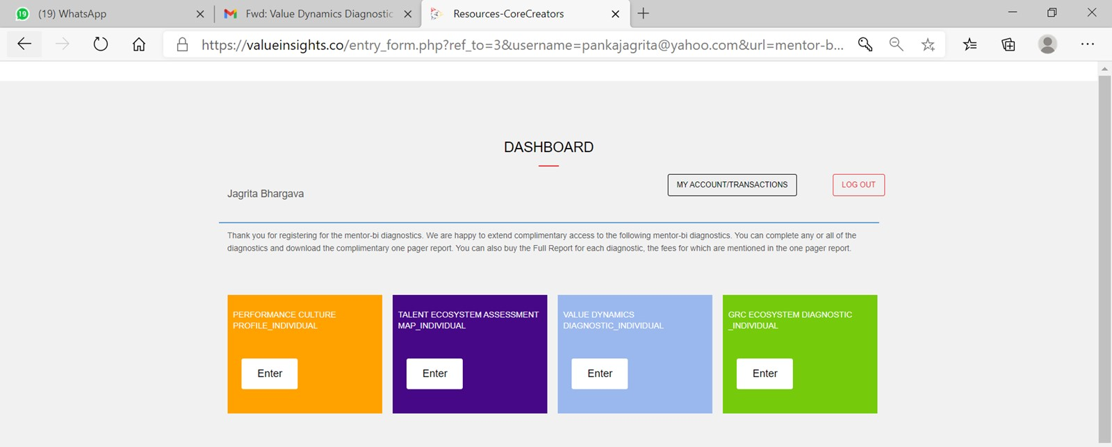
Hope the “Resources – Core Creators” will change once the site link is live. This has been given as feedback before as well. What will it say? Words like “valueinsights” will be fine. done

Slide 3
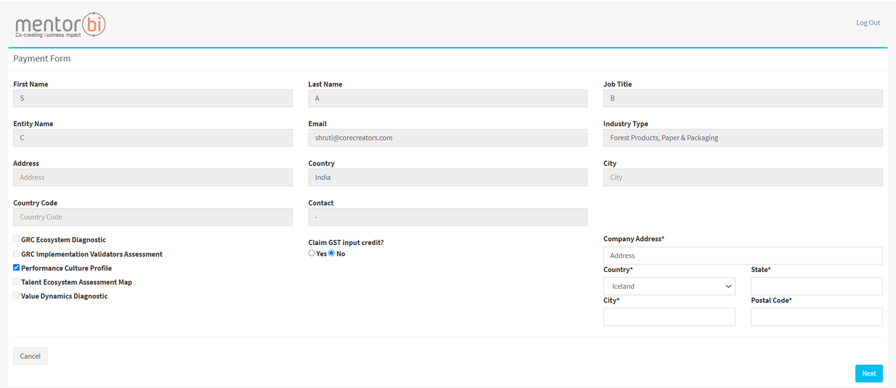
State should not be visible as a field for International locations as not every country will have a state – this feedback was given in review 9 but has not been fixed. For India, it should show Country|State (drop-down)|City| Postal Code for International locations, it should show Country|City|Postal Code. done
Country for the invoice is registered as Iceland, the invoice is coming in USD (see next slide) but the amount should be blank since we have not finalized the fees for international locations – the fees are not USD 1000. done
From which Country Field is the data being picked up in the final invoice – the one highlighted in red or blue? It should be the one highlighted in red

Slide 4
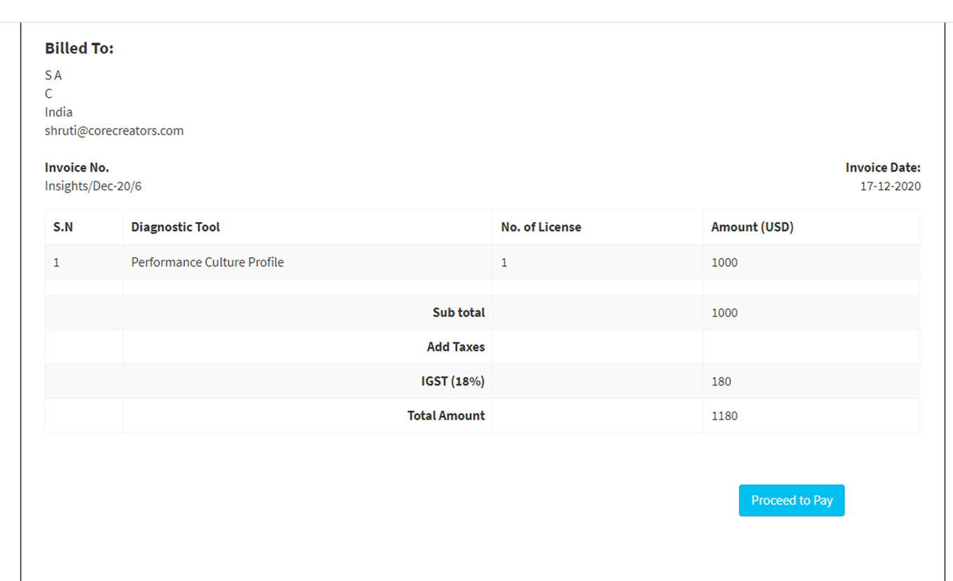
The USD figures are not yet finalized, so this should show zero, unless this has been put as dummy data. done
Please check if the amount field has been linked to the INR fees and if so it needs to change to where the data will be stored in the system for USD fees. done

Slide 5
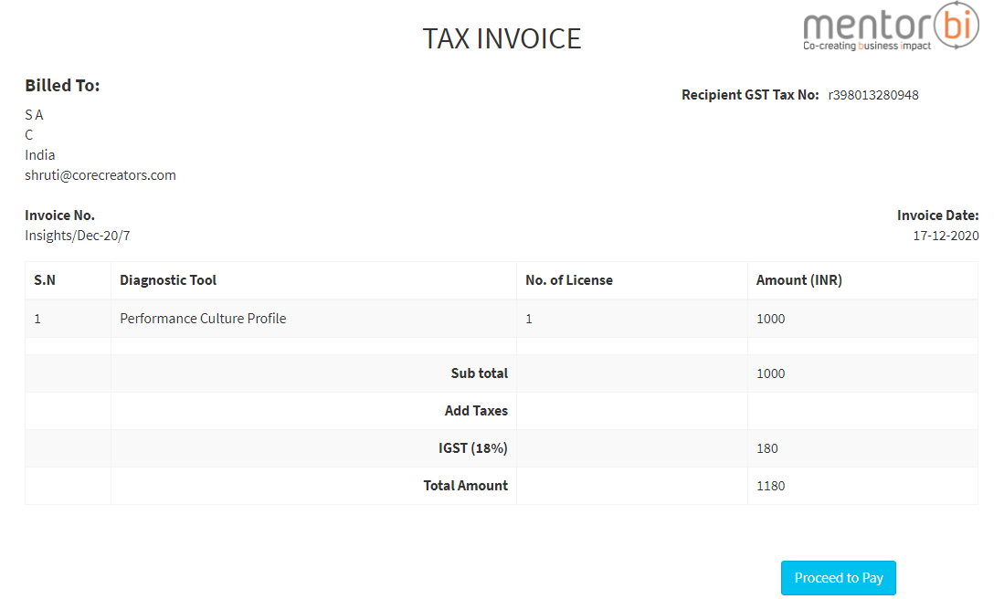
The GST calculation format for states other than Maharashtra is correct. But where the State is Maharashtra, as provided in the Invoice template it should show data for CGST and SGST and not IGST. (see the invoice format provided).
CGST (9%)
SGST (9%)
As provided in the Sample invoice format, mention all the taxes in the template
CGST (9%)
SGST (9%)
IGST (18%)
When the buyer mentions the state as Maharashtra, the tax amounts should be shown for CGST and SGST and IGST should be blank
Where the buyer mentions any state other that Maharashtra or any international country, the tax amount should be shown for IGST and CGST and SGST should remain blank
For India, the State should be visible in the address here before Country. done
Remove the word “tax” – it should say Recipient GST No. done
It should say No. of Licenses Purchased – as has been provided in the sample template done

Slide 6
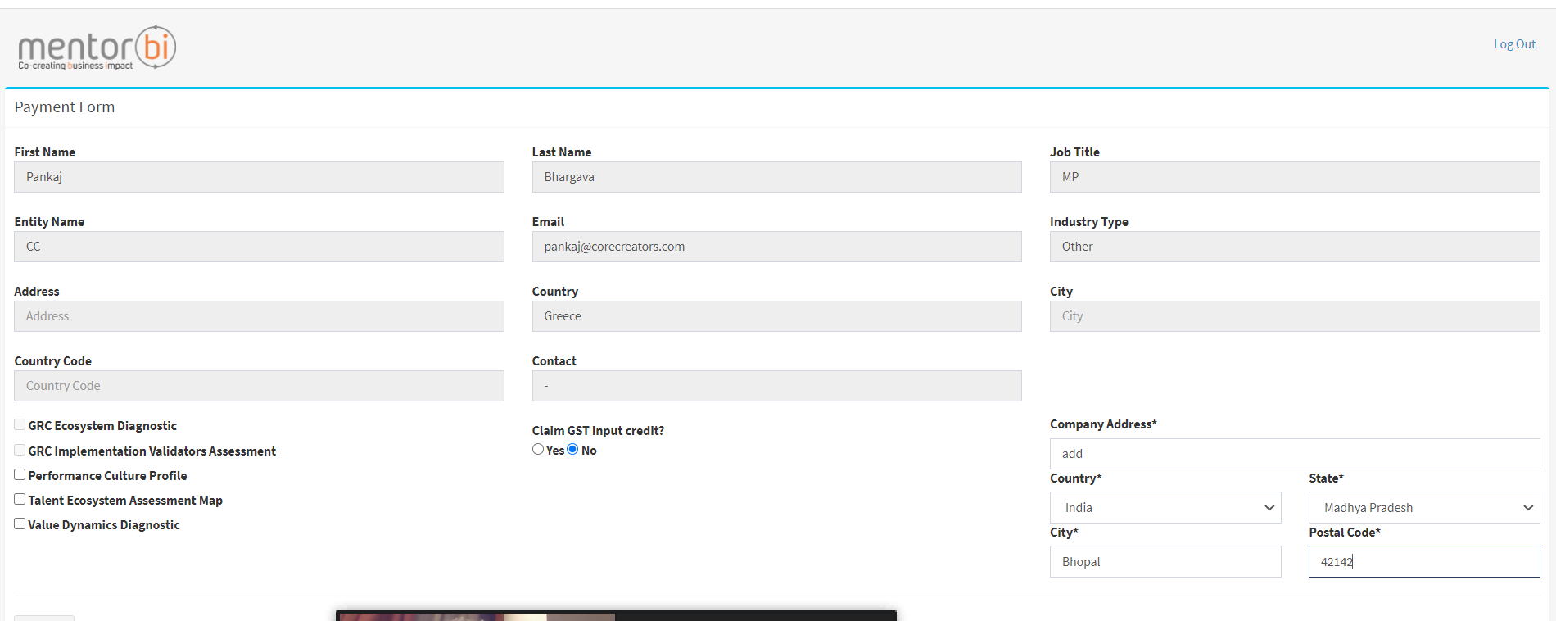
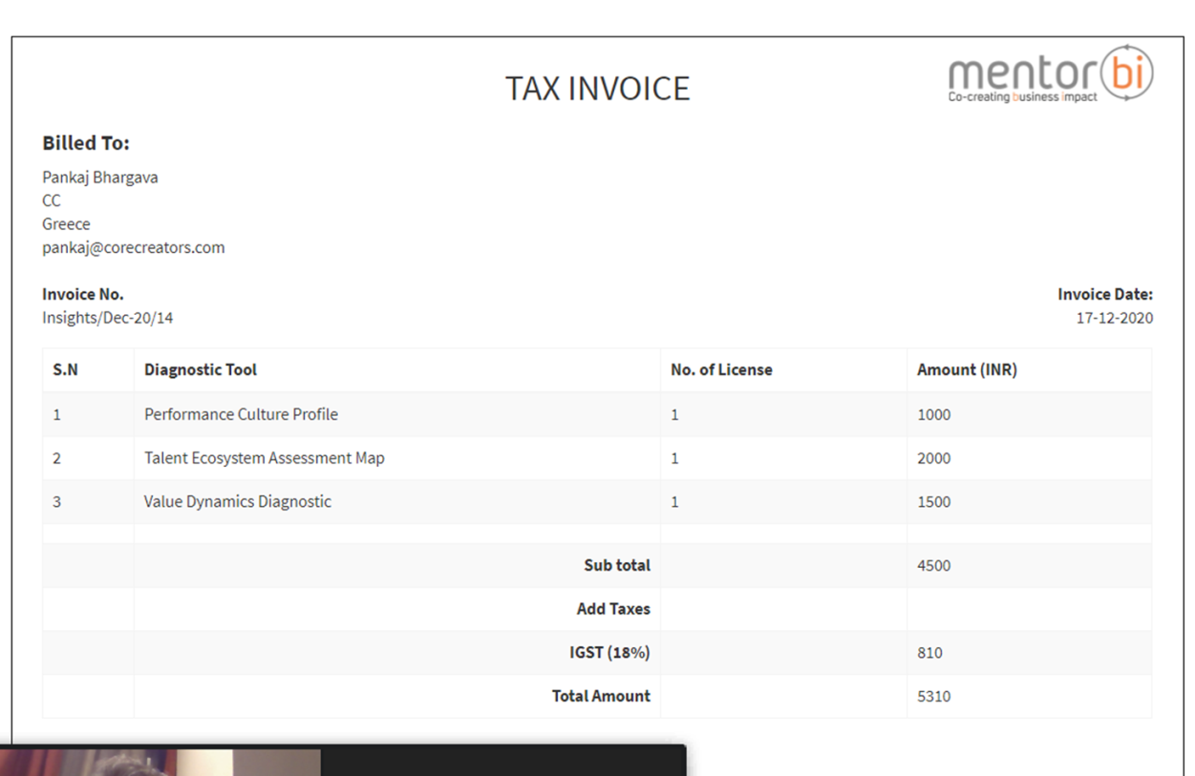
The address, city, country, postal code data that has been provided by the user at the time of registration should be automatically populated in this box.
Only the missing fields should be editable e.g. address, city, state (for India) postal code which the user may not have provided at time of registration since they are non mandatory at the time of registering for the Individual diagnostic.
The address in the invoice should come from the place highlighted by red border
Postal code should not be included in the address in the invoice – so all the fields highlighted in red above excluding the postal code should be populated in the invoice

Slide 7
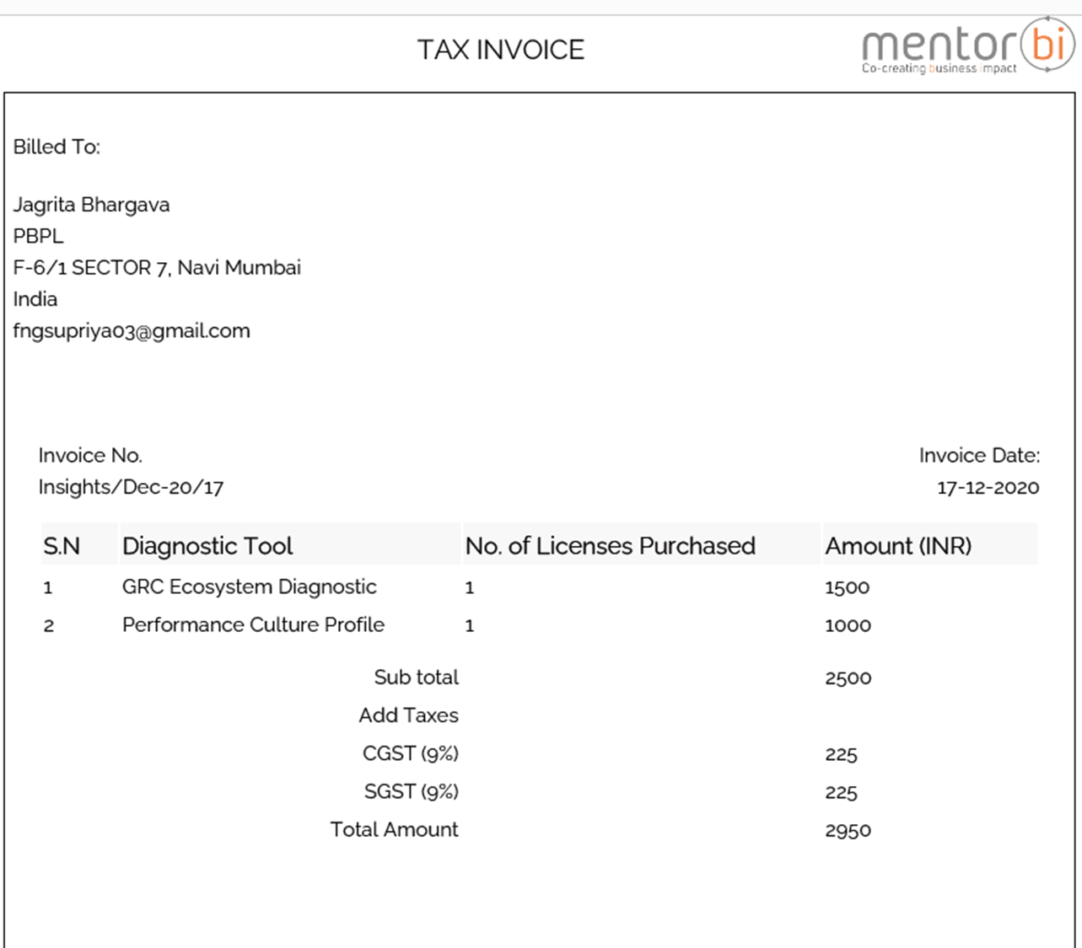
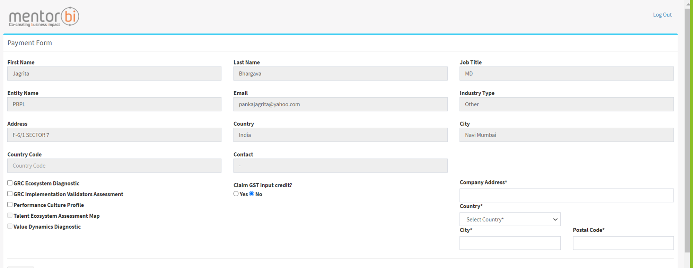
View of Payment Form from GRC Implementation Validators Assessment. The checkbox should not be active for the diagnostics for which I have already paid
I have already paid for the GRC Ecosystem Diagnostic and Performance Culture profile as can be seen from the invoice above. So, it should not ask me to pay for these 2 diagnostics again when I am buying a full report for another diagnostic.

Slide 8
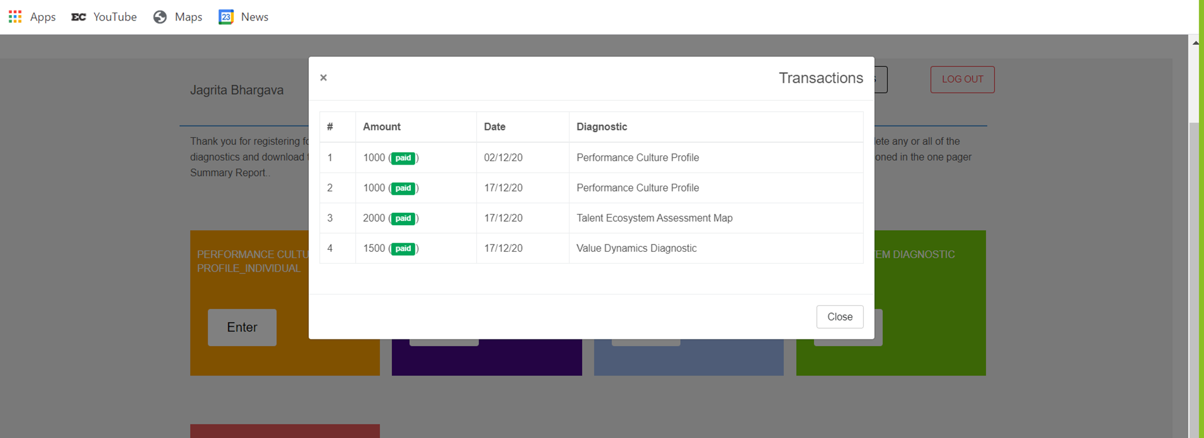
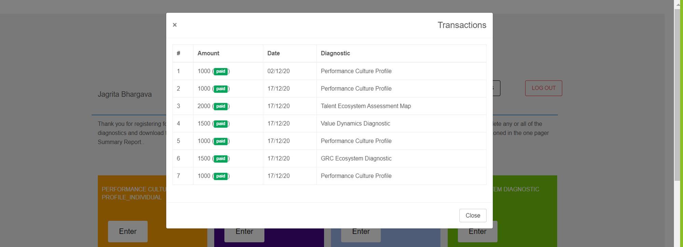
We had discussed this on call as follows
Since we are giving the diagnostics free for individual account, the Amount column should be blank, but all the diagnostics should be listed along with the date.
The amount should be visible in the Amount column when someone purchases the full report. Paid in bracket should also be visible, but “P” should be capital.
done
Also, when I am actually making the payment, it is getting recorded as a separate transaction instead of being recorded as buying the full report for the same diagnostic.
See next slide for proposed view and guidelines to show the Transactions
done

Slide 9
Transactions
Diagnostic | Summary Report | Full Report
Value Dynamics Diagnostic | Complimentary | Paid Feature
Performance Culture Profile | Complimentary | Paid Feature
This is what the table should look like when an individual account holder accesses Transactions after opening their Individual Account - default
It should list all the diagnostics, only 2 are shown here as an e.g. done
Diagnostic | Summary Report | Full Report
Value Dynamics Diagnostic | Complimentary | INR 2000 (Paid)
Performance Culture Profile | Complimentary | Paid Feature
The data in the Full Report column should change as shown above once say the user buys the full report for any of the diagnostics. See example for Value Dynamics Diagnostic in the above table.
It should list all the diagnostics, only 2 are shown here as an e.g. done

Slide 10
Entity Diagnostic: mentor-bi Admin

Slide 11
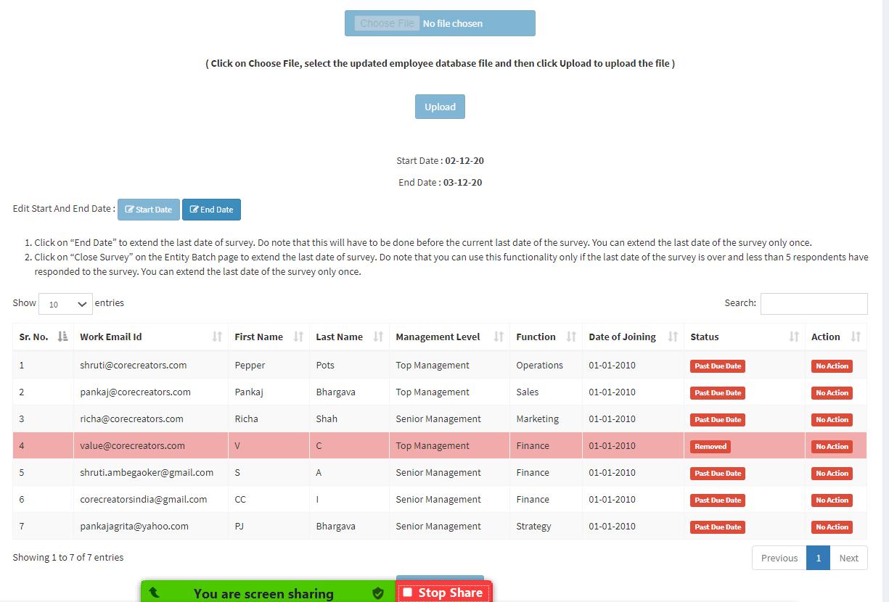
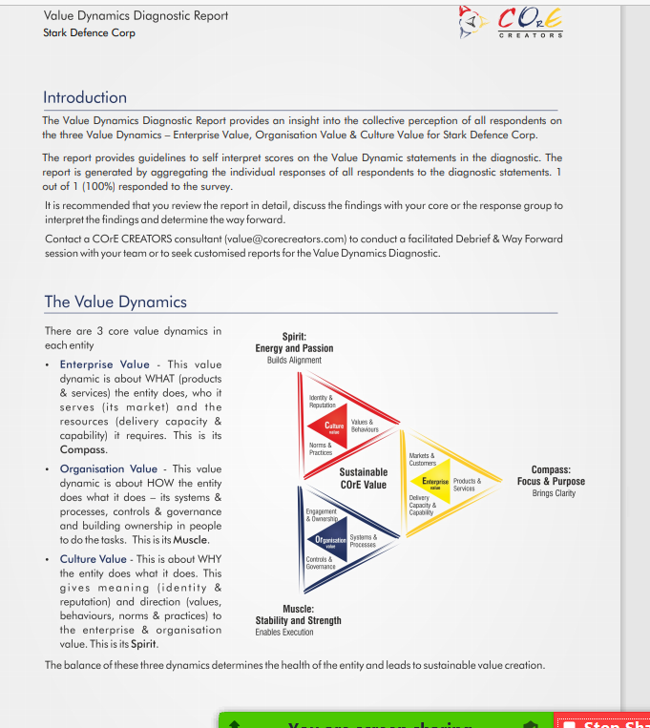
VDD (CC) - Only 1 person has responded to the survey but the report is generated. There have to be at least 5 responses for the report to be generated
Also the report could be downloaded without clicking on the “Generate report” button. We have said that the Admin will click on Generate Report to generate the report, else the report will not get generated.
The %age calculation in the report is still incorrect. E.g. in this case it should show1 out 5 (20%) responded to the survey.

Slide 12
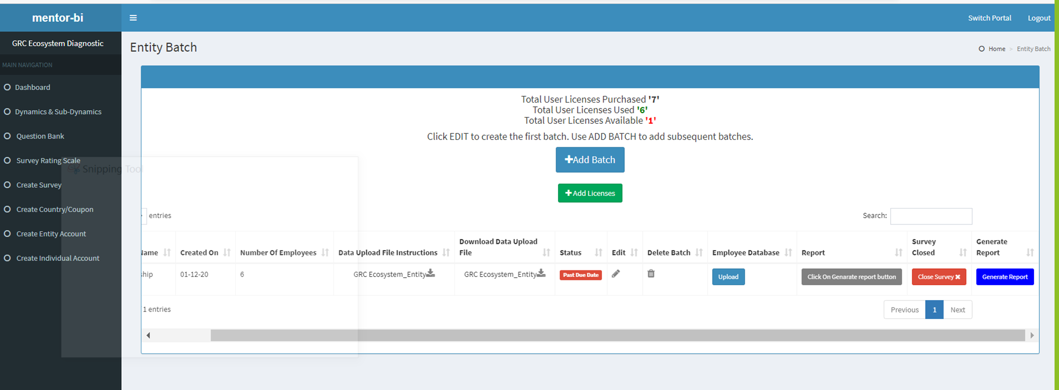
Nothing happens when I click on “Generate Report” button and once I close the survey, the report gets generated automatically.
The functionality that we have discussed is as follows:
A report can be generated only when there are 5 responses (see previous slide where a report is getting generated with only 1 response
A report can be generated only when the survey is closed
Once the survey is closed, then the Mentor/CC Admin will click on the “Generate Report” button and the report will get generated. It will not get generated automatically on closing the survey .

Slide 13
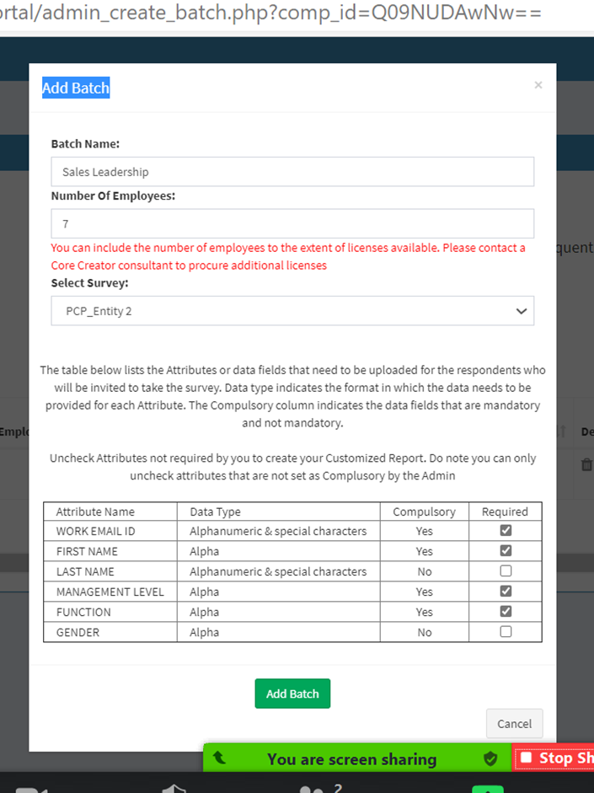
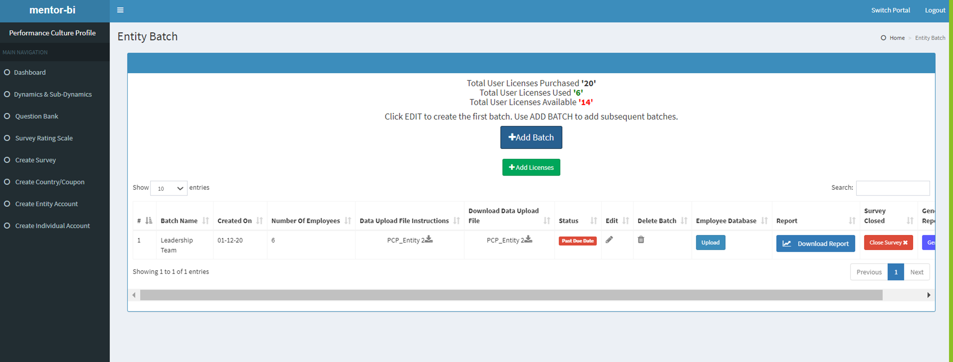
There are 14 licenses available but it is now allowing a batch of 7 respondents to be created
For mentor diagnostics, replace Core Creator consultant with mentor-bi team – this would be applicable for all mentor-bi diagnostics except VDD (CC)

Slide 14
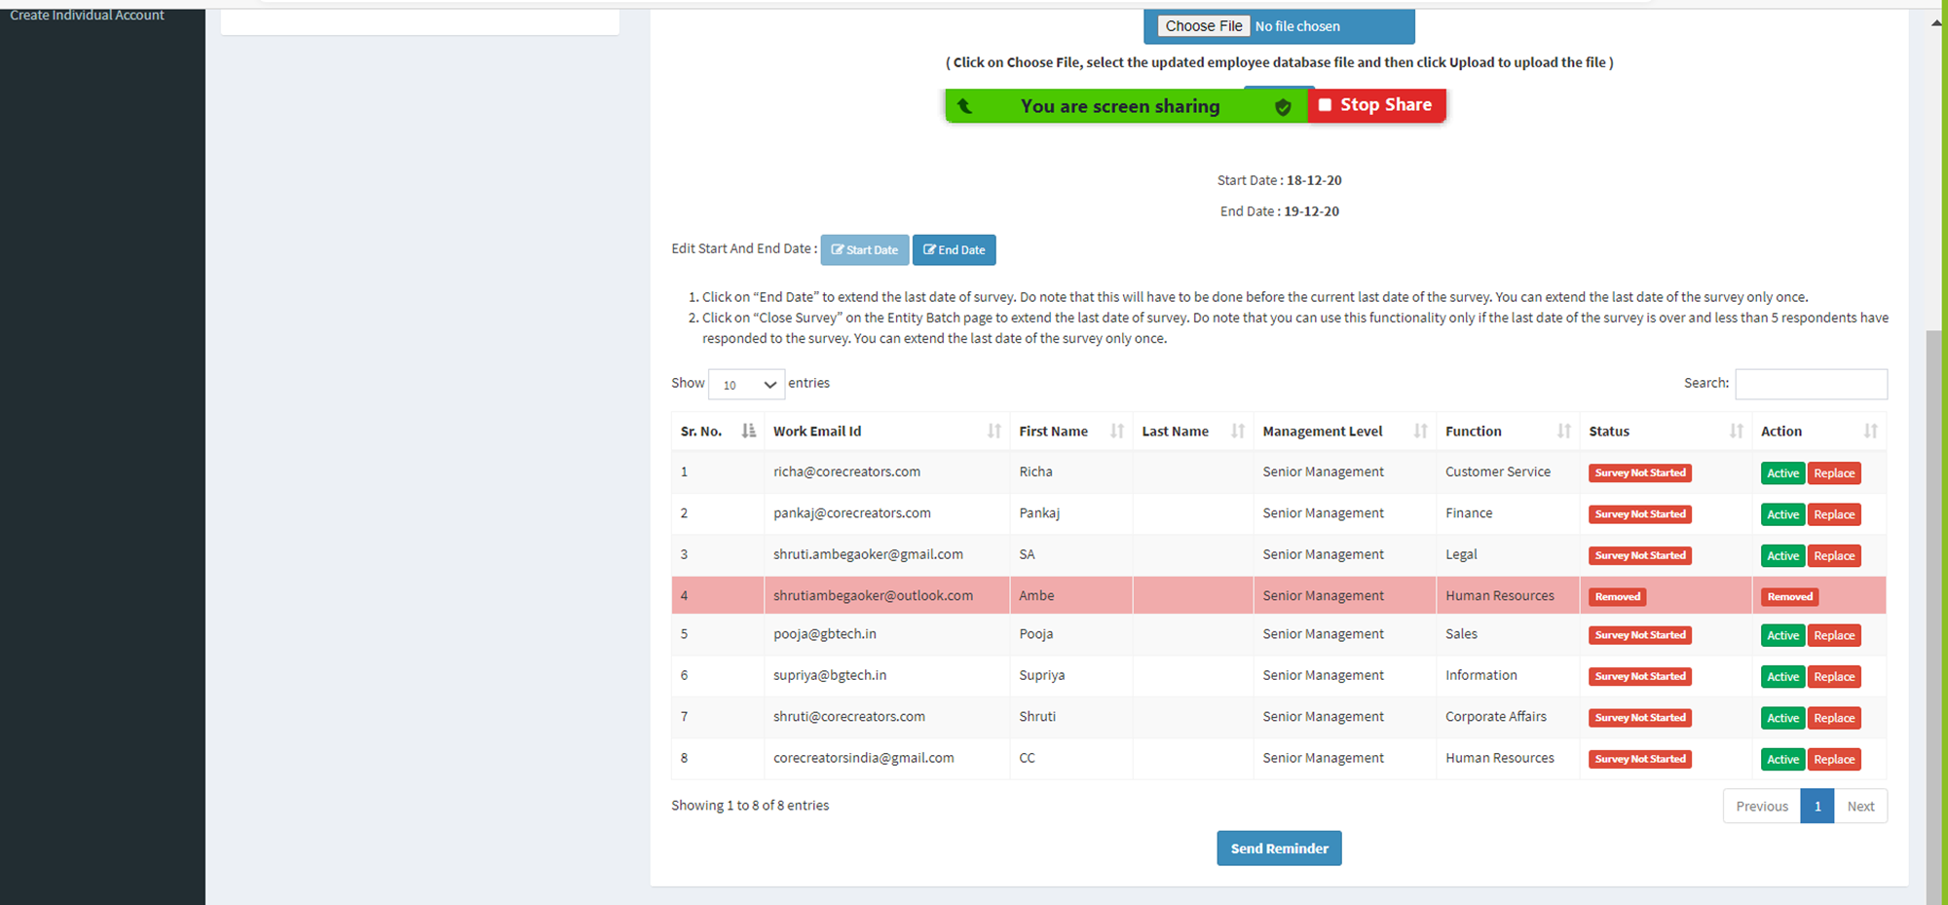
While I was able to delete and replace a respondent, the new invitee (corecreatorsindia@gmail.com) did not get the survey invite email – which they should have to get their login credentials to complete the survey.

Slide 15
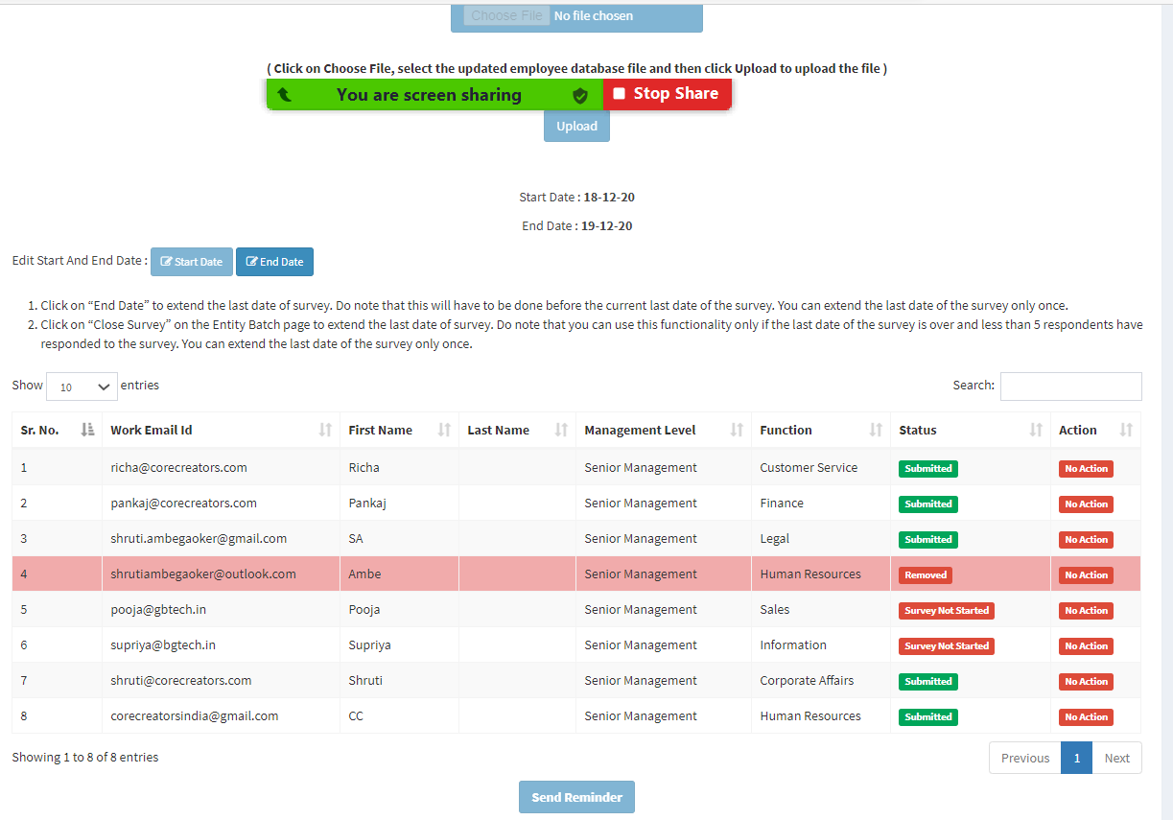
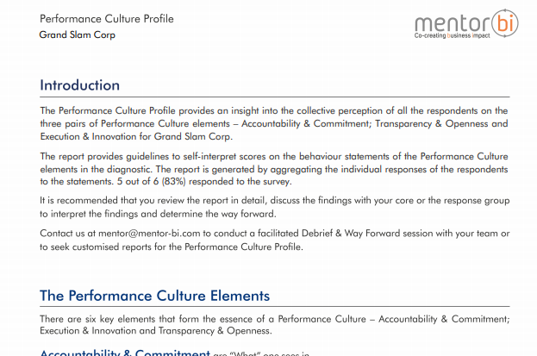
There are 7 invitees, but the report is taking only 6 – why is that?

Slide 16
Performance Culture Profile: Entity Raw Data
 |  |  |  |  |  |  | Accountability & Commitment | Accountability & Commitment | Accountability & Commitment | Accountability & Commitment | Accountability & Commitment | Accountability & Commitment
 | Attribute 1 Name | Attribute 2 Name | Attribute 3 Name | Attribute 11 Name | Attribute 12 Name |  | Accountability | Accountability | Accountability | Commitment | Commitment | Commitment
Enity name | S.N | Work Email Id | First Name | Last Name | Management Level | Function | Expectations from each other are shared clearly. | Individuals take ownership for what is expected of them. | Appropriate processes exist to enable setting clear expectations and to hold people accountable for delivering on the expectations. | Individuals walk the talk - say what they do & do what they say. | Each one can be counted on to do what they commit to do. | There are clear consequences for demonstrating or not demonstrating commitment.
Grand Slam Corp | 1 | richa@corecreators.com | Richa |  | Senior Management | Customer Service |  | 3 | 4 | 4 | 5 | 5
Grand Slam Corp | 2 | pankaj@corecreators.com | Pankaj |  | Senior Management | Finance |  | 3 | 4 | 4 | 5 | 6
Grand Slam Corp | 3 | shruti.ambegaoker@gmail.com | SA |  | Senior Management | Legal |  | 4 | 4 | 5 | 4 | 4
Grand Slam Corp | 4 | shruti@corecreators.com | Shruti |  | Senior Management | Corporate Affairs |  | 6 | 6 | 4 | 3 | 2
Grand Slam Corp | 5 | corecreatorsindia@gmail.com | CC |  | Senior Management | Human Resources |  | 5 | 5 | 5 | 3 | 2
 |  |  |  |  |  |  | Statement Average | 4.2 | 4.6 | 4.4 | 4 | 3.8
 |  |  |  |  |  |  | Dynamic Average | 4.4 |  |  | 3.68
Data has shifted to the right by 1 column – this is a problem for raw data in both Individual and Entity diagnostic for all diagnostics.

Slide 17
Entity Diagnostic: Client Admin

Slide 18
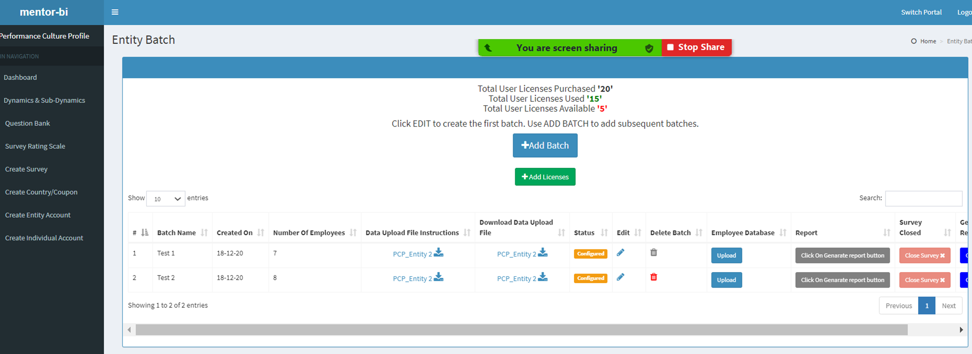
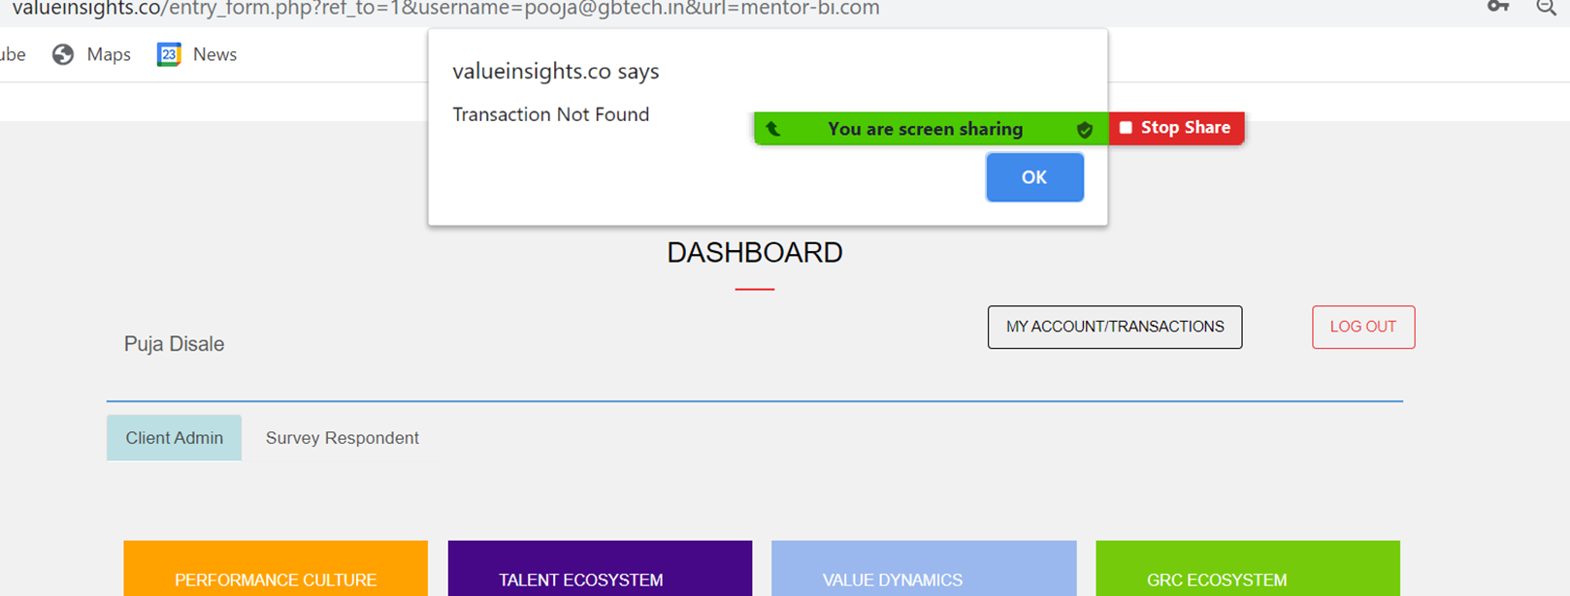
Pooja has created an Entity Account with 10 licenses and to it, I added another 10 licenses.
However, on logging through the client portal and clicking on “Transactions”, the pop message says “Transaction Not Found”, which is incorrect.
The system should show both the transactions for PCP. done

Slide 19
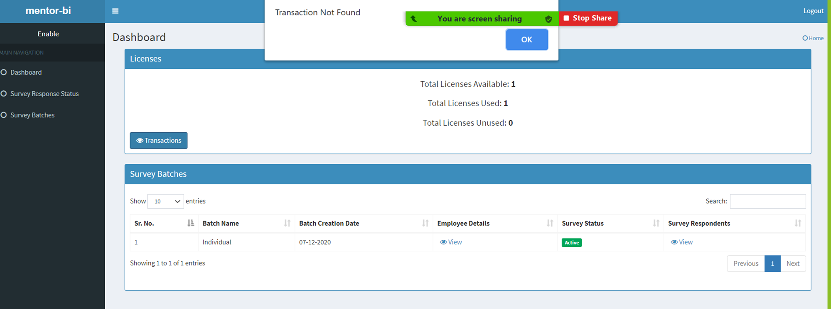
Continuing with the Client Admin portal, went from PCP (previous slide) to VDD.
First on the left top corner, it shows the word “Enable” instead of “Value Dynamics Diagnostic”
Second, there is 1 license bought and used (this is Entity account view), yet on clicking “Transactions” the pop up says “Transactions Not Found” . This issue is across all the Diagnostic in the Entity account done

Slide 20
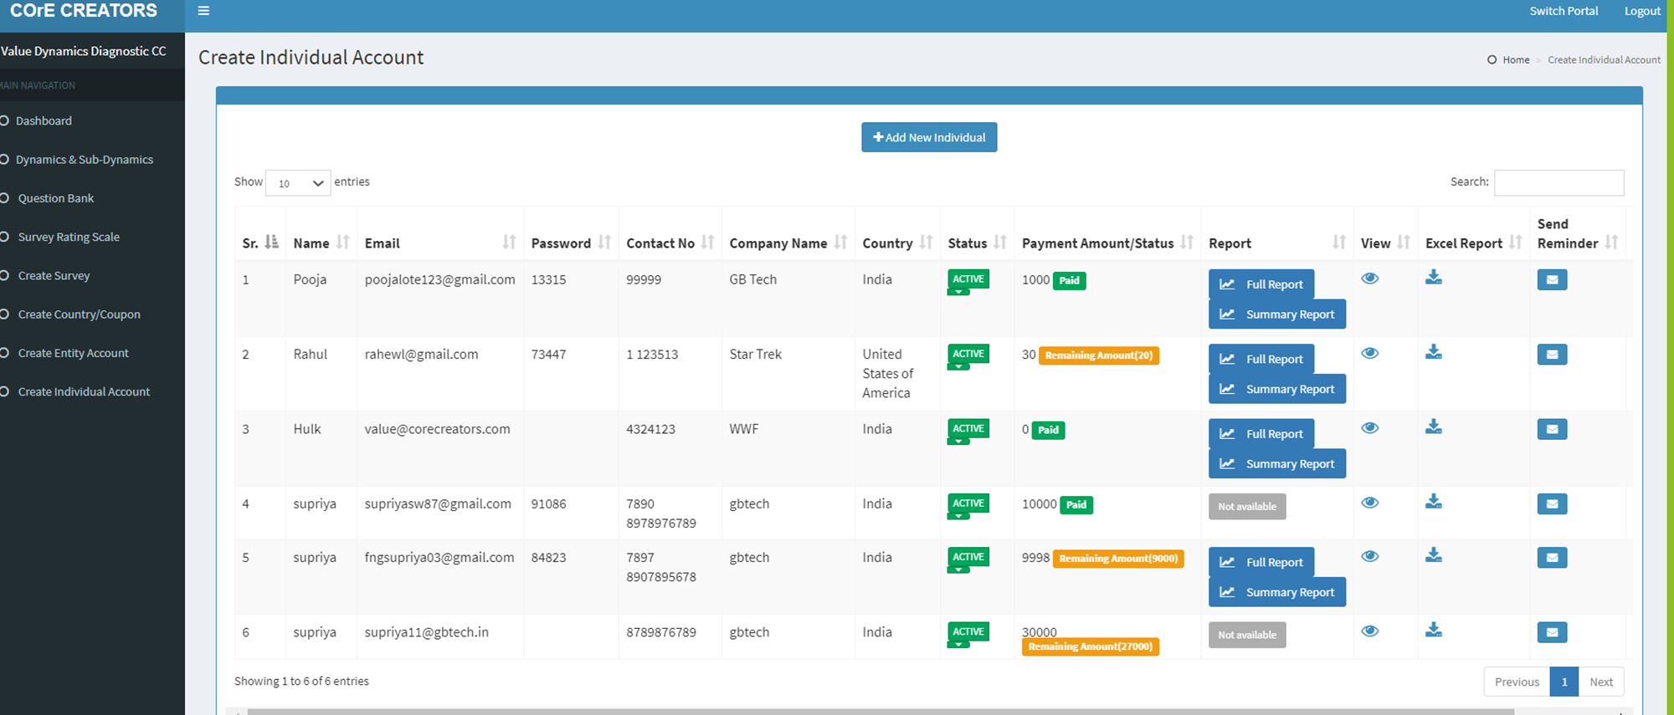
Replace “Remaining Amount” with “Amount Due” - it will be shorter done

Slide 21
Entity Diagnostic: CC VDD

Slide 22
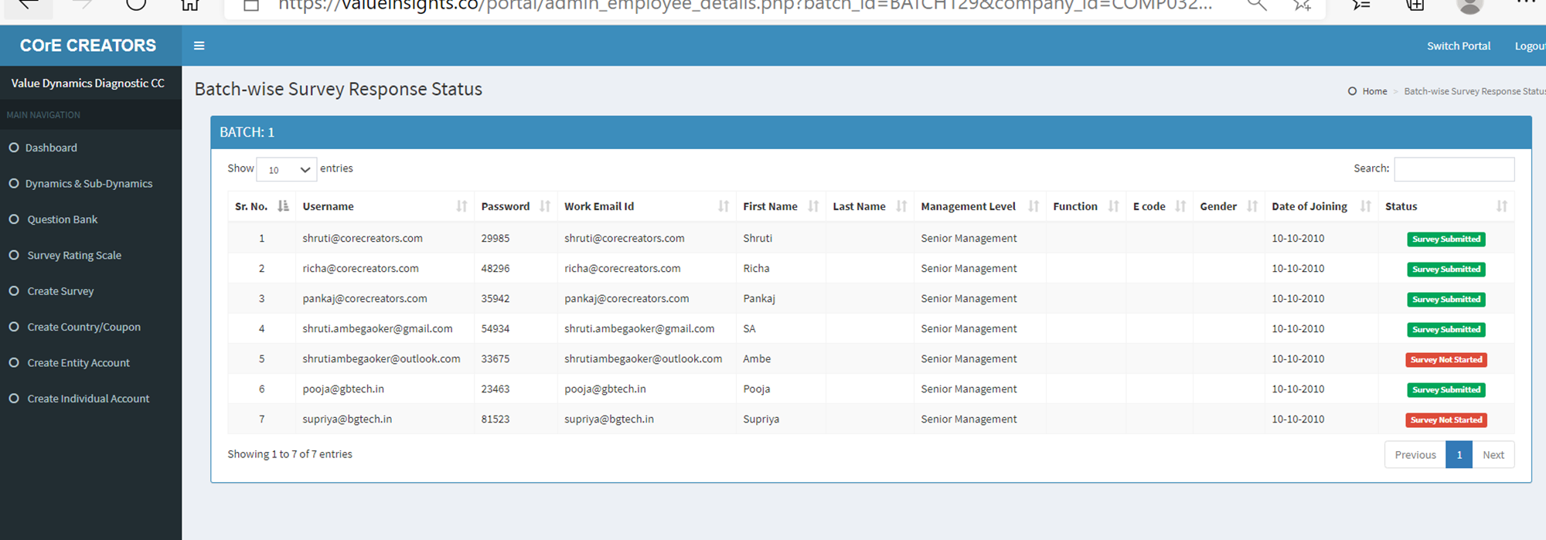
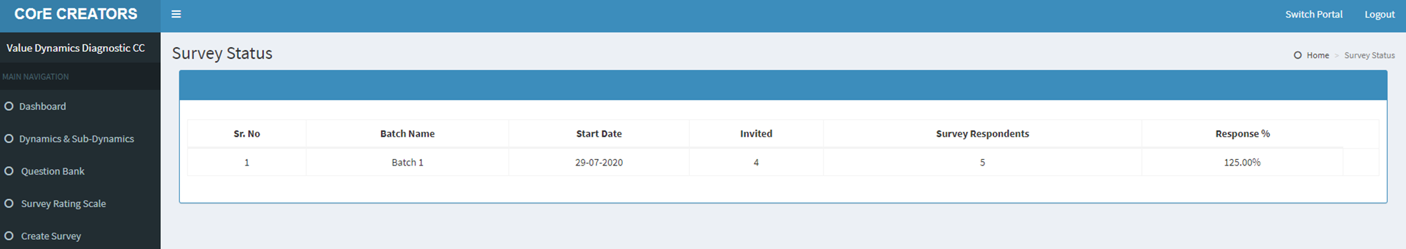
There are 7 people who are invited to respond to the survey and 5 have responded to the survey. This data is captured incorrectly in the Survey Status for all surveys in VDD CC. This issue is encountered in some of the other diagnostics. It needs to be fixed across all diagnostics to ensure that the invited and responded data is captured correctly. Also does the data in the report come from this Survey Status page – because the percentage calculation in most reports in incorrect. done

Slide 23
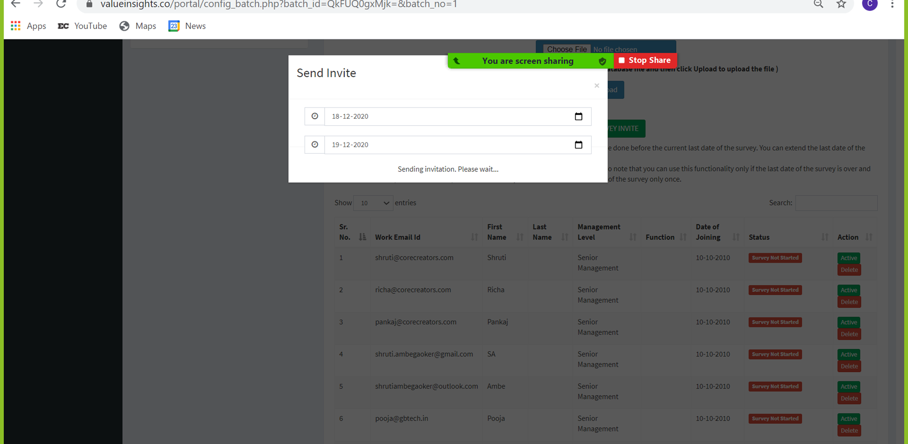
As highlighted on 2 Dec the page hangs – experienced that today also – on refreshing the page, can see that the username and passwords are generated. In the first round the page hung but no email went out to the survey invitees. In the 2nd round, the page hung but after refreshing it, the survey invite emails went to the invitees except for those with corecreator email id.
Also the field for “No of questions per page” is sometimes visible and sometimes not visible. done

Slide 24
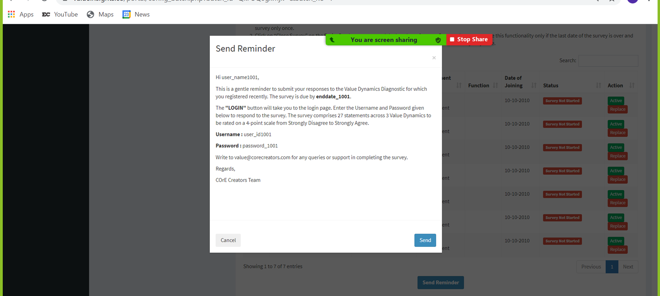
As highlighted on 2 Dec the page hangs – experienced that today also – on refreshing the page, nothing happens
In the first round of testing, no reminder mails went to the invitees. In the 2nd round of testing, the page hung but after refreshing, the reminder mail went to the survey invitees except to those with corecreators id. done

Slide 25
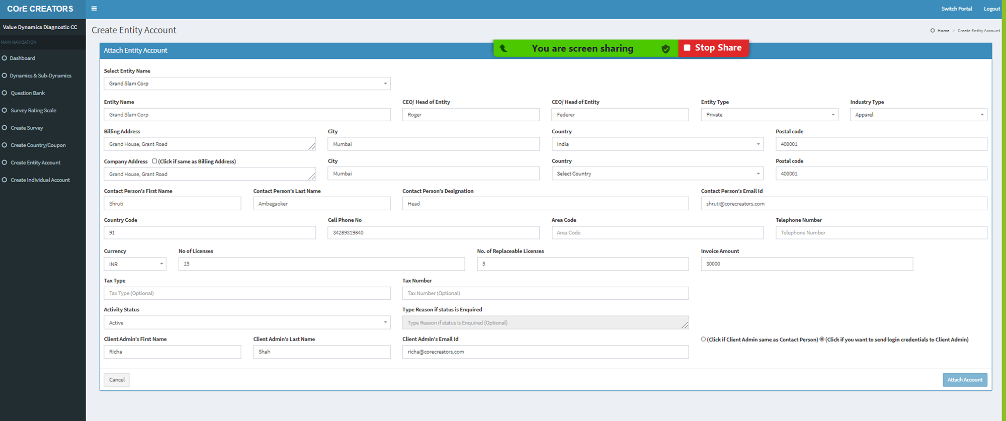
Nothing happened after I clicked the “Attach Account” button, but when I refreshed the page and checked “Create Entity Account”, the account was already created. I didn’t get the email notifying me that the Entity Account has been created
This issue was raised on 2nd Dec but doesn’t seem to have been resolved. done

Slide 26
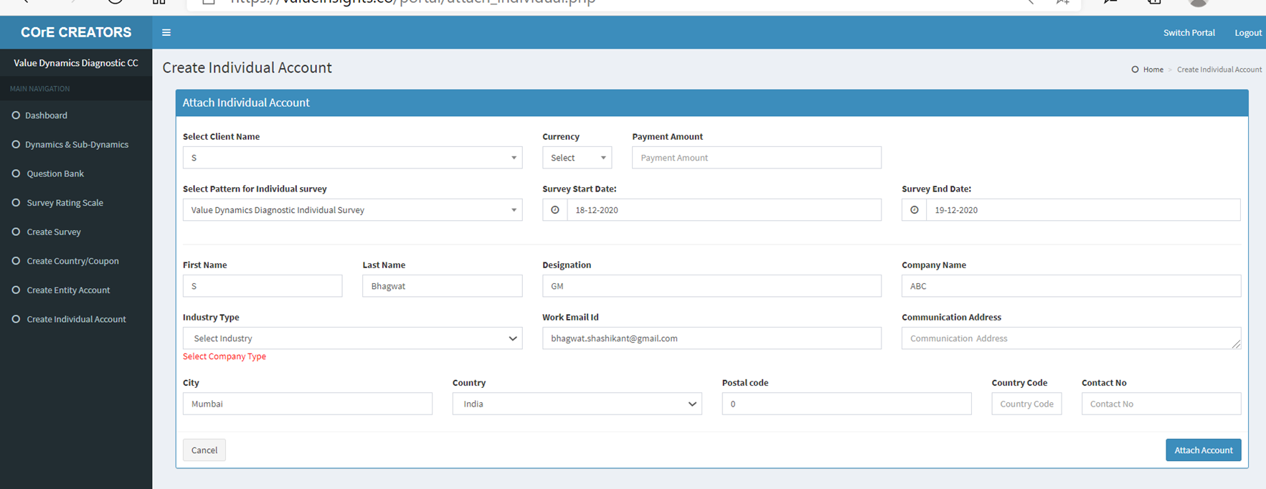
Replace “Company” with “Industry” in the above alert message in red. done

Slide 27
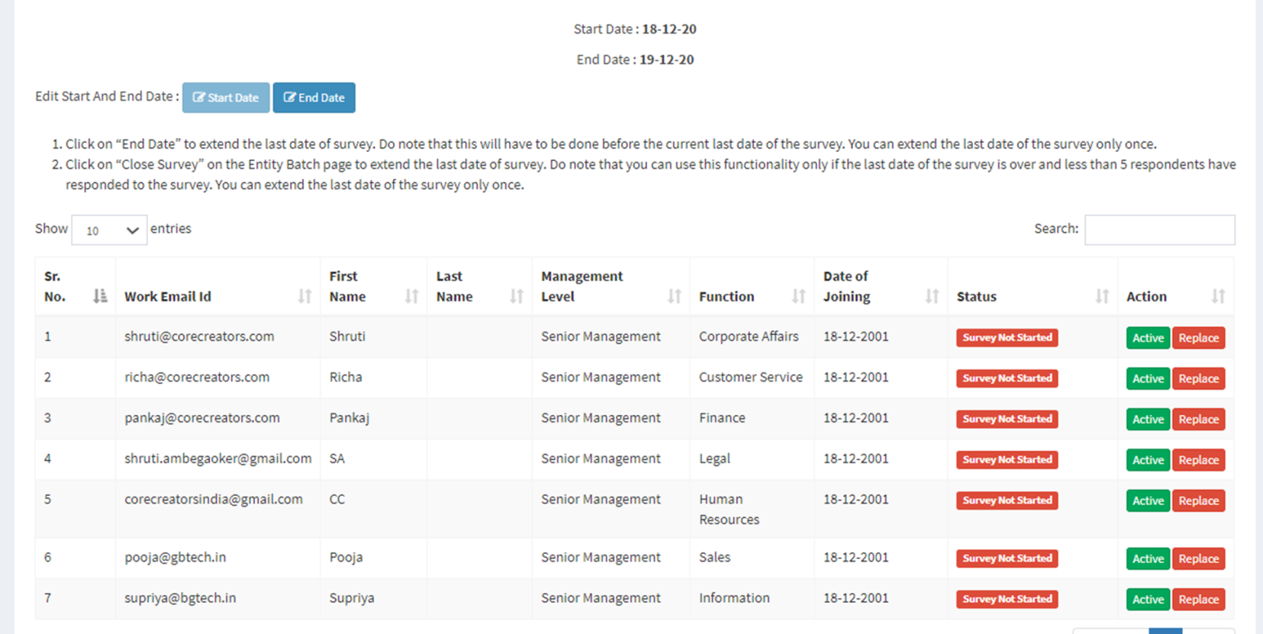
First Round of Testing
Second Round of Testing
The page layouts were also different in the first and second round of testing today – see how Active & Replace in seen in the first round of testing as compared to the 2nd round. What is seen in the 2nd round is the common view across all diagnostics.

Slide 28
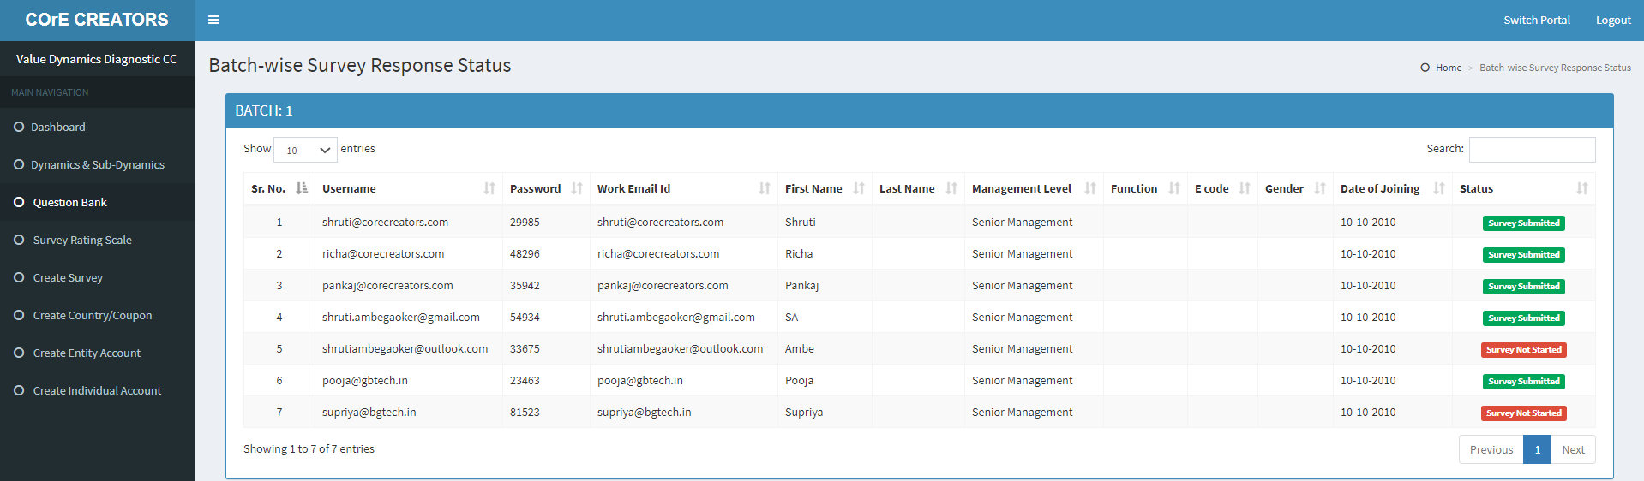
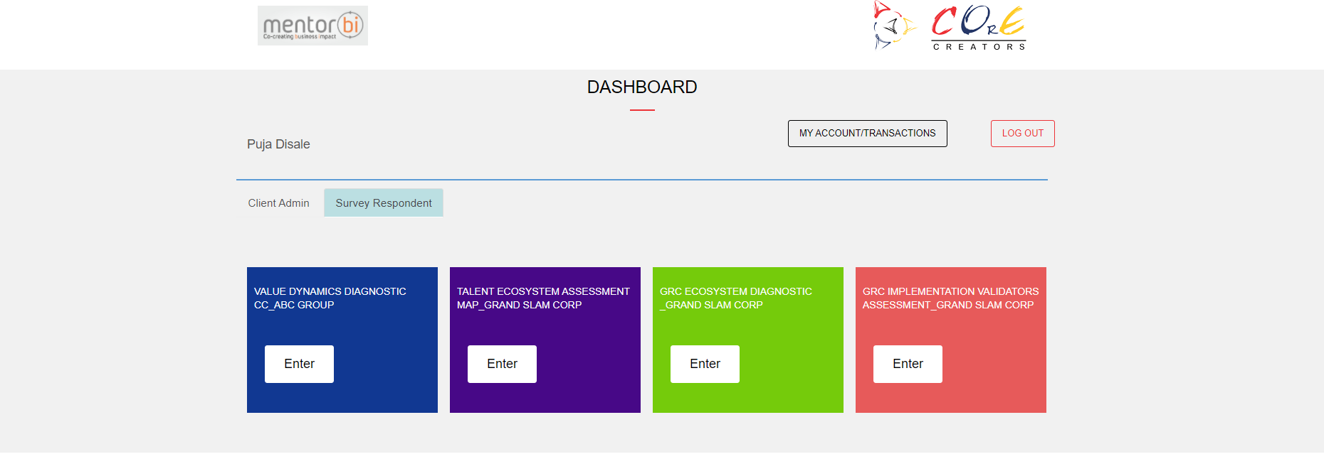
Pooja has responded to the CC VDD but when one logs into her account, CC VDD is not visible among the tiles under Survey Respondent (whether you log in through mentor website or CC test website link.
Similarly, CC VDD is not visible in the Survey Respondent for any of the people who have submitted their responses

